Slide 1



Geospatial analysis using GEE for Remote Sensing and Agriculture
Kulvanth S, Praveen Pankajakshan, Kumar Rajamani,
praveenpankaj@ieee.org

Slide 2
Contents
Raison d’etre
Geospatial AI
Applications
Remote Sensing Introduction
Satellite Imaging
Data, Compute and Learning
Google Earth Engine
Hands on walk through with examples
Case Studies: NDVI for Crop Extent Analysis

Slide 3
With the End in mind!

Slide 4
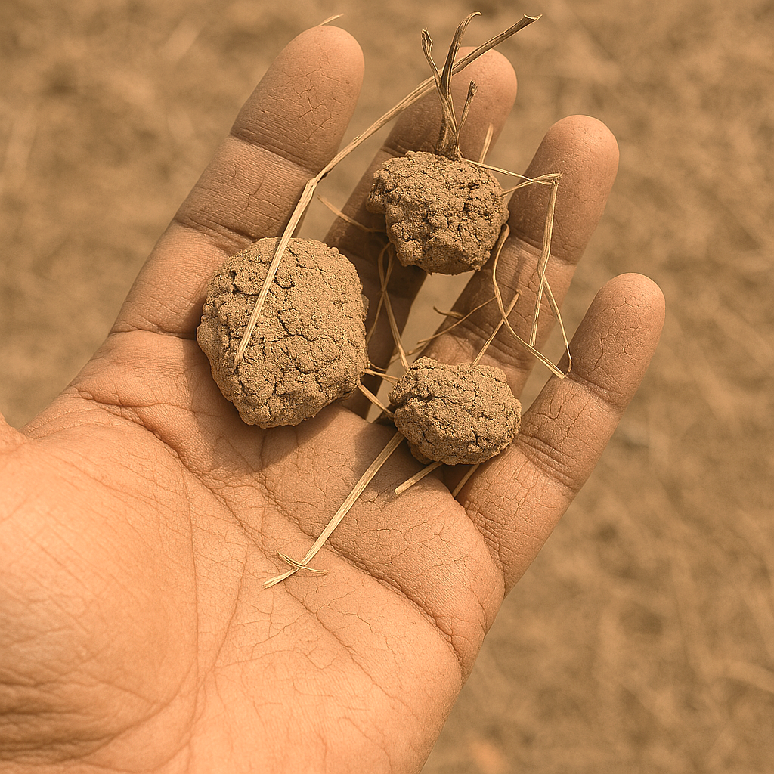
Agriculture-Not Business as usual!

Slide 5
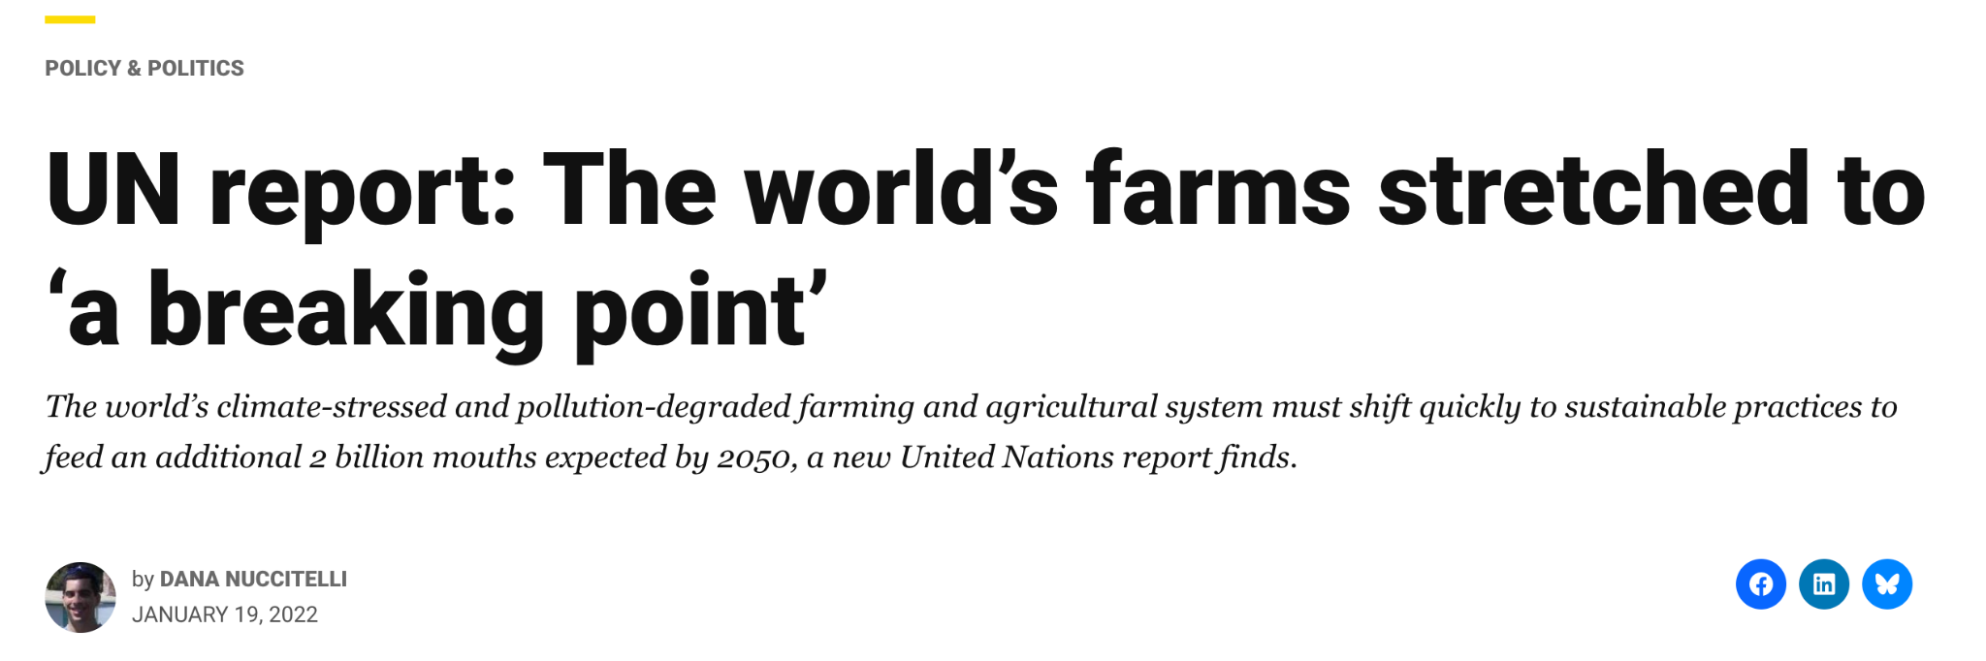


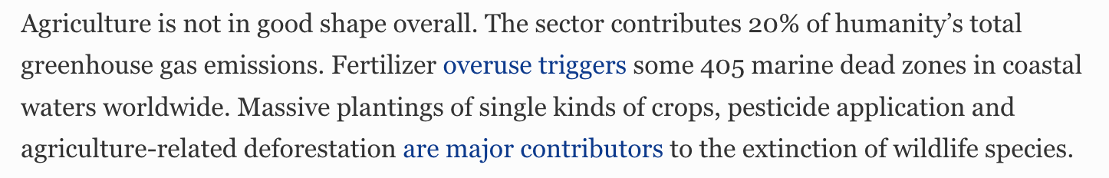

Slide 6



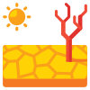
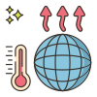
Biodiversity Loss and Climate Change threatens food security
Monocultures and intensification has eroded genetic diversity, and increased vulnerability to diseases, pests, and climate shocks.
Just 12 plants provide 75% of the world’s nutrition!
75% of global food crops depend on pollinators. Populations are declining due to climate, habitat loss and pesticides.
~One-third of the topsoil in the Corn Belt has been lost. Globally, ~ 33% soils are moderately to highly degraded. (Slide 5)
With climate change, many existing agriculture lands will become unsuitable to grow crops (Slide 6).

Slide 7
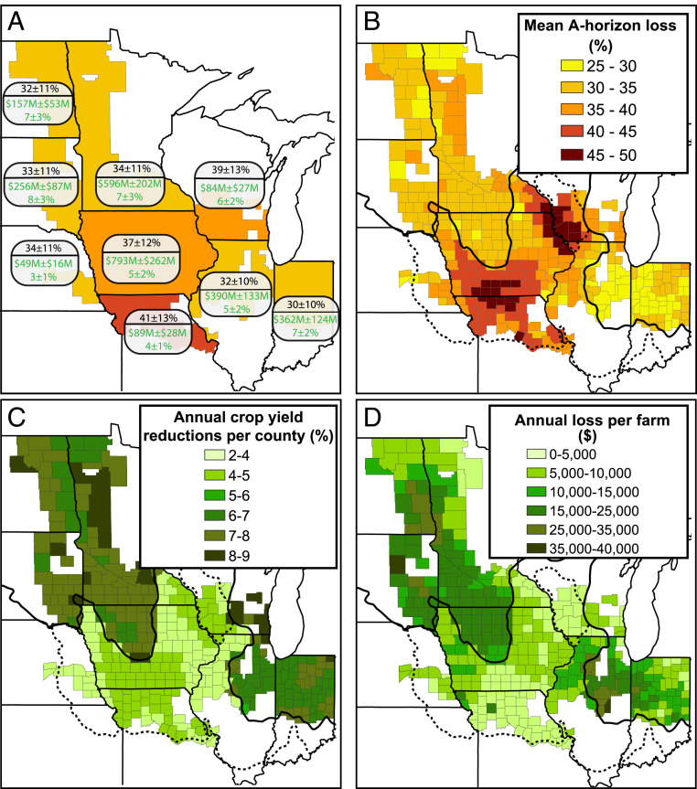
Extent of soil loss and impact across the US Corn Belt
(B) Loss of the topmost layer of soil containing the highest concentration of organic matter, nutrients, and biological activity, (C) loss in yield and (D) revenue loss per farm
(A) Aggregated percent A-horizon loss (black text) and annual economic losses expressed in millions of dollars (M) and as a percentage relative to uneroded soils (green text) for each state within the region.

Slide 8
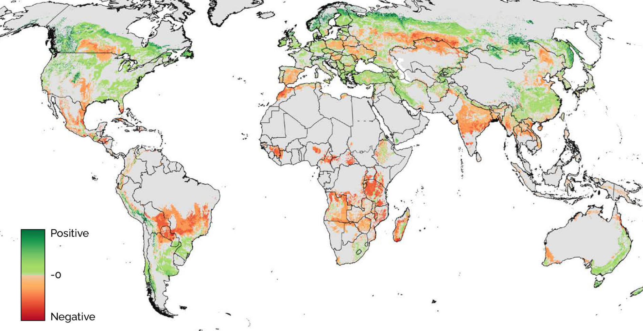
Change in Crop Growing Suitability
Shifts in land areas suitable for rainfed wheat for a high-emission/high-temperature scenario to the 2080s (RCP 8.5), leading to a 4.2 °C temperature increase

Slide 9
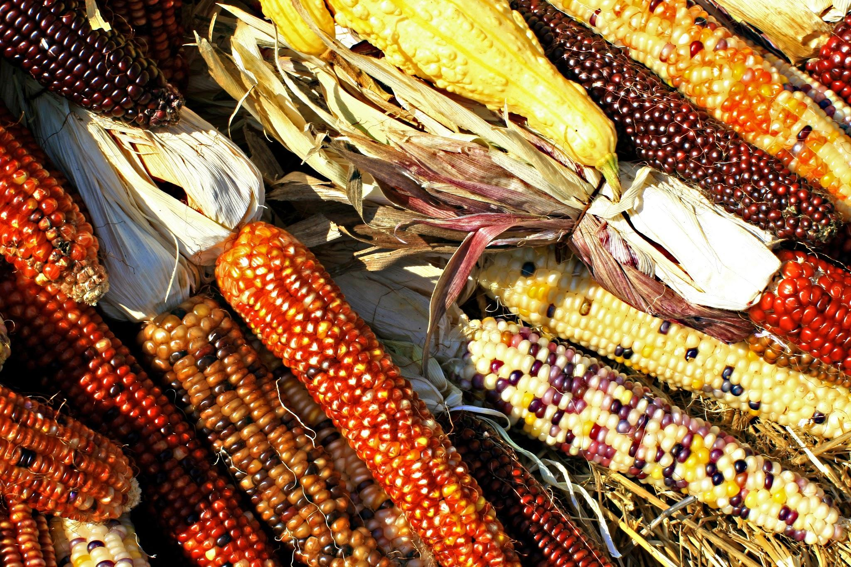
We cannot change the past but we can create a better future!

Slide 10
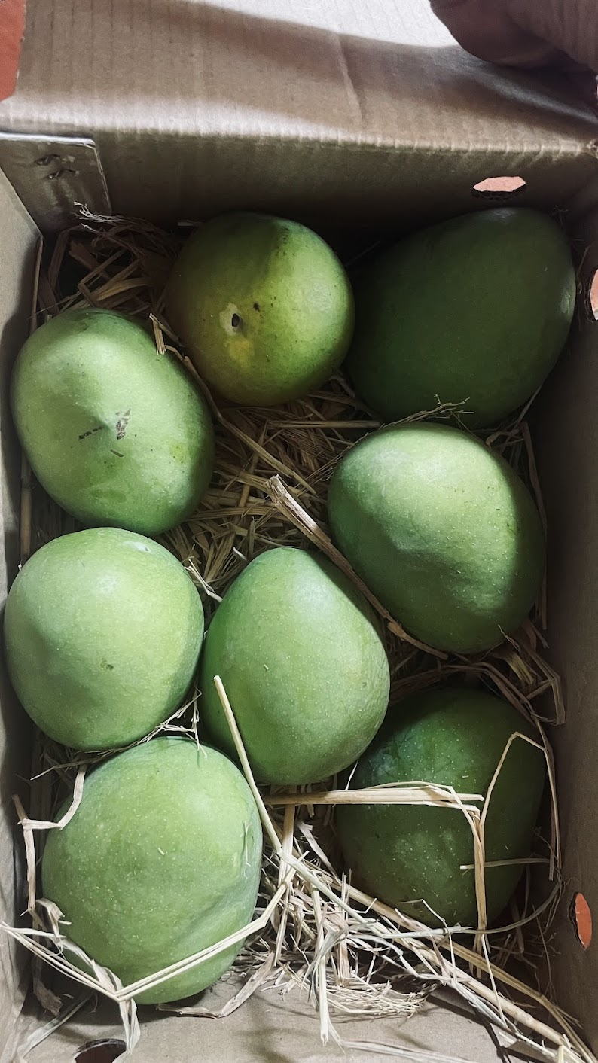
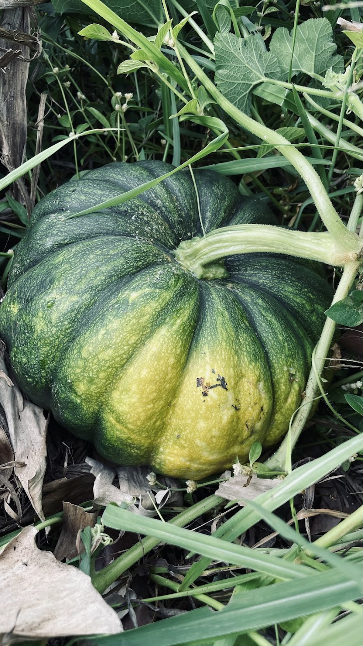
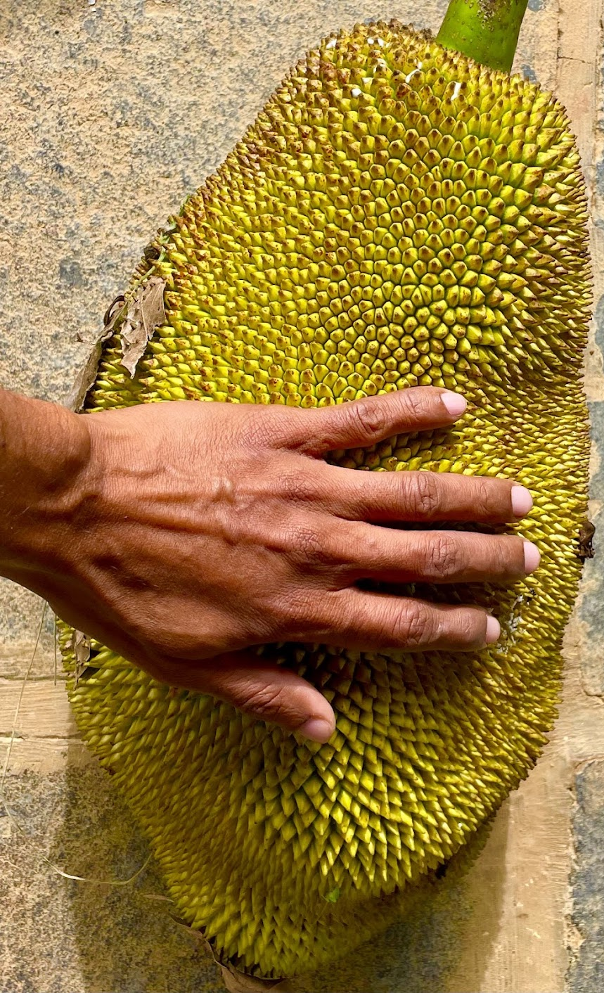
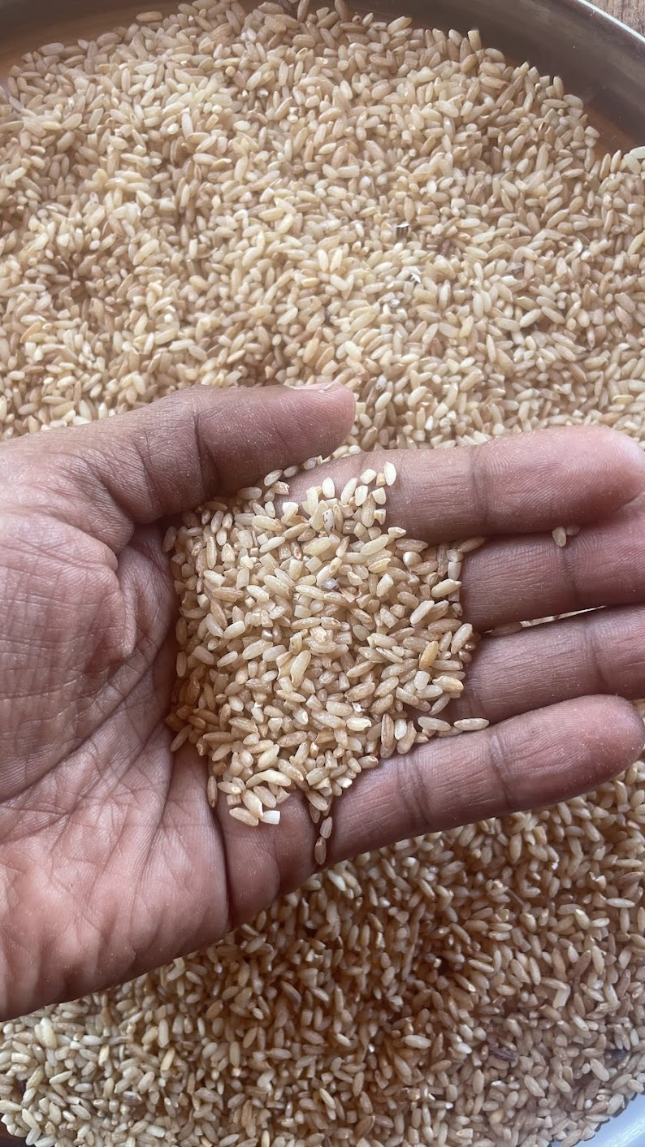
Produce from the GAIA Earth community lab

Slide 11
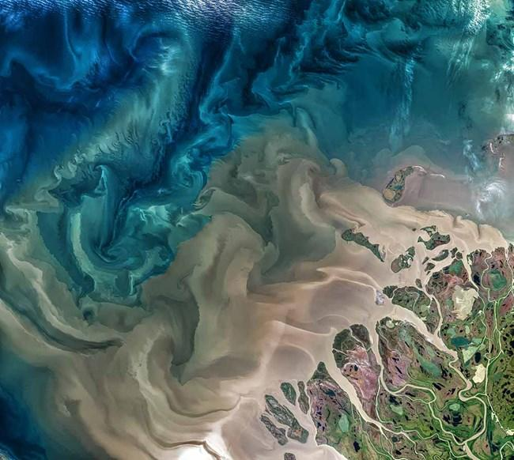
Geospatial AI

Slide 12
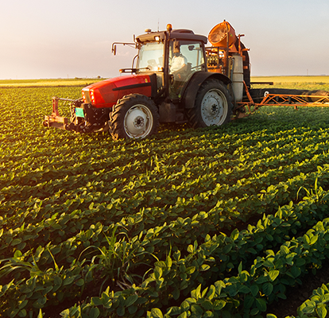
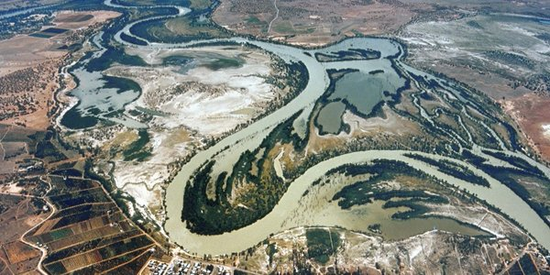
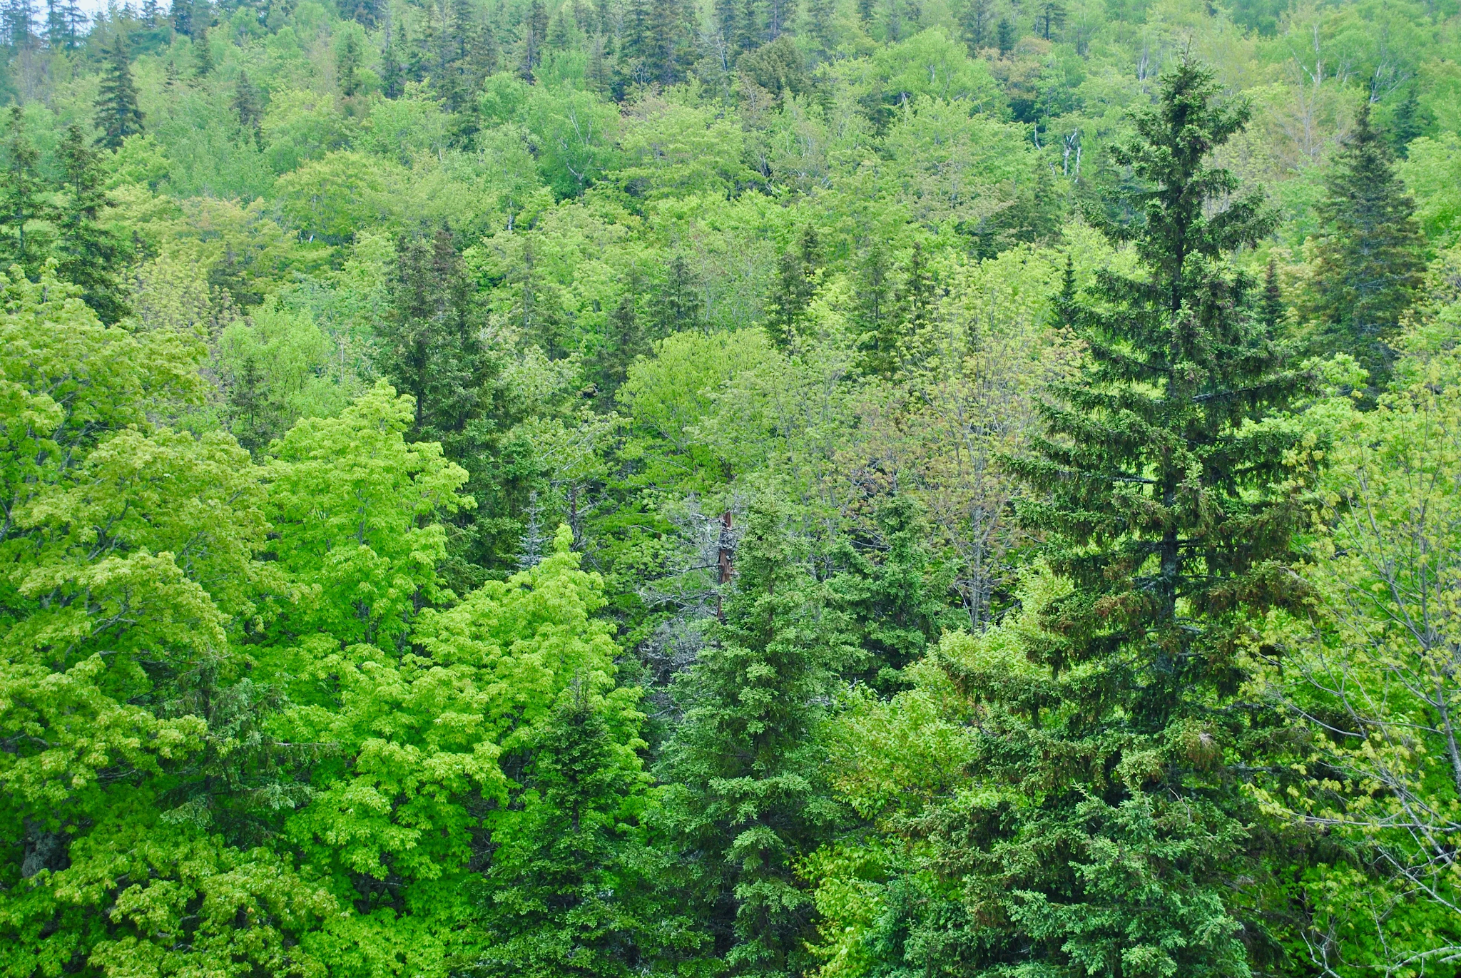
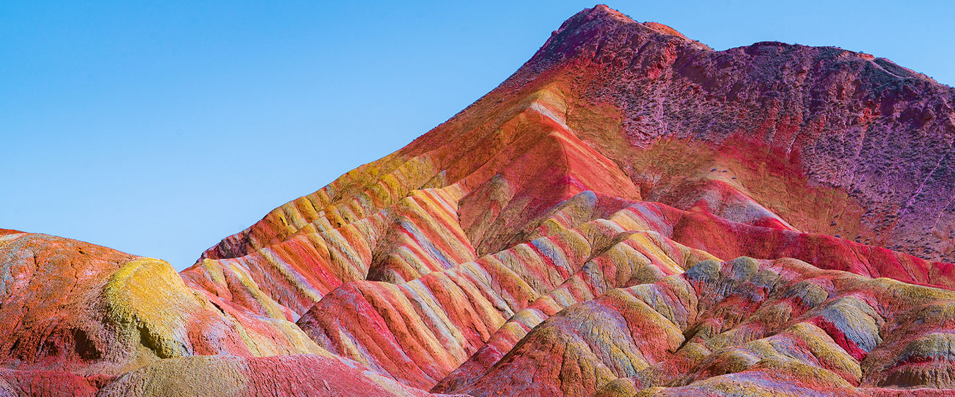
Systemic Integration Agriculture
Farm
Environment
Forestry
Geology

Slide 13
Not Obvious Applications

Slide 14
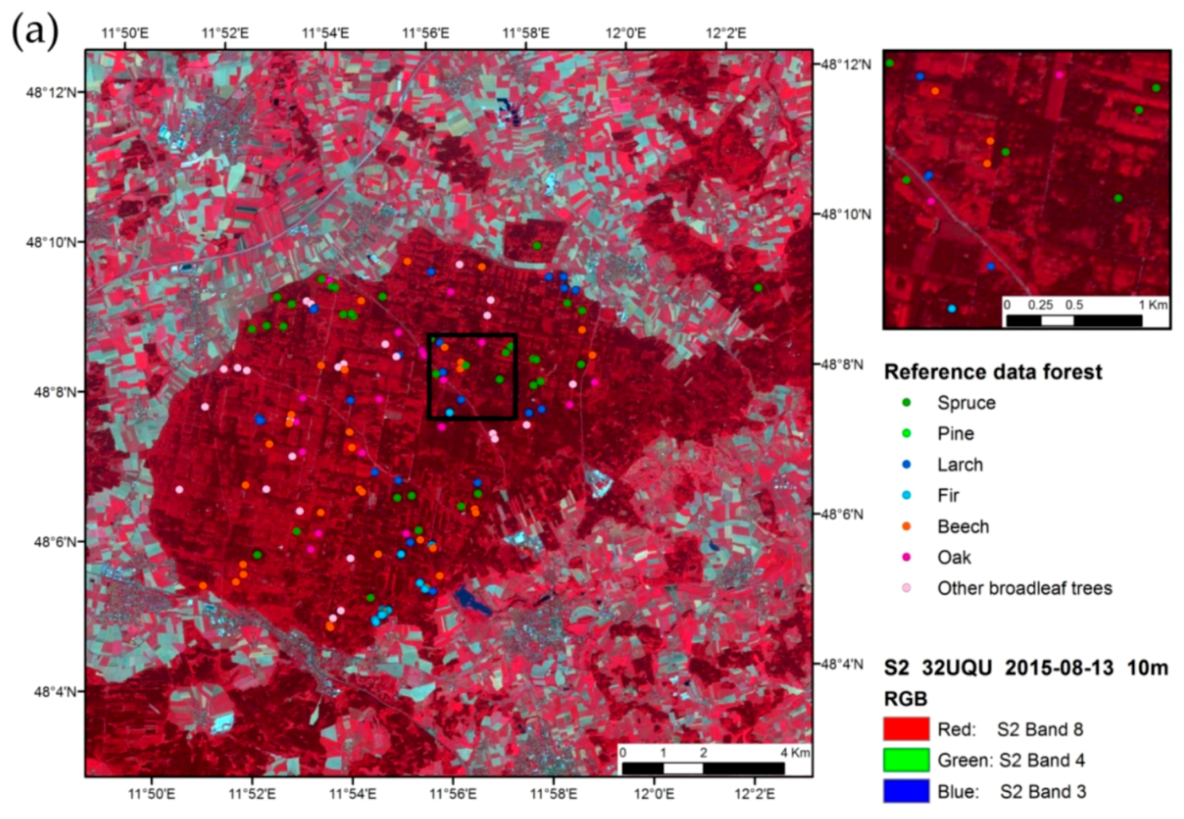
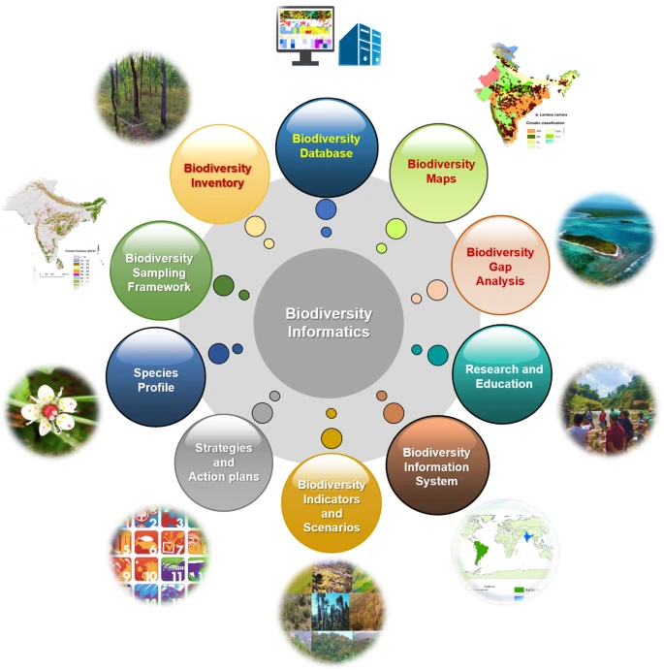
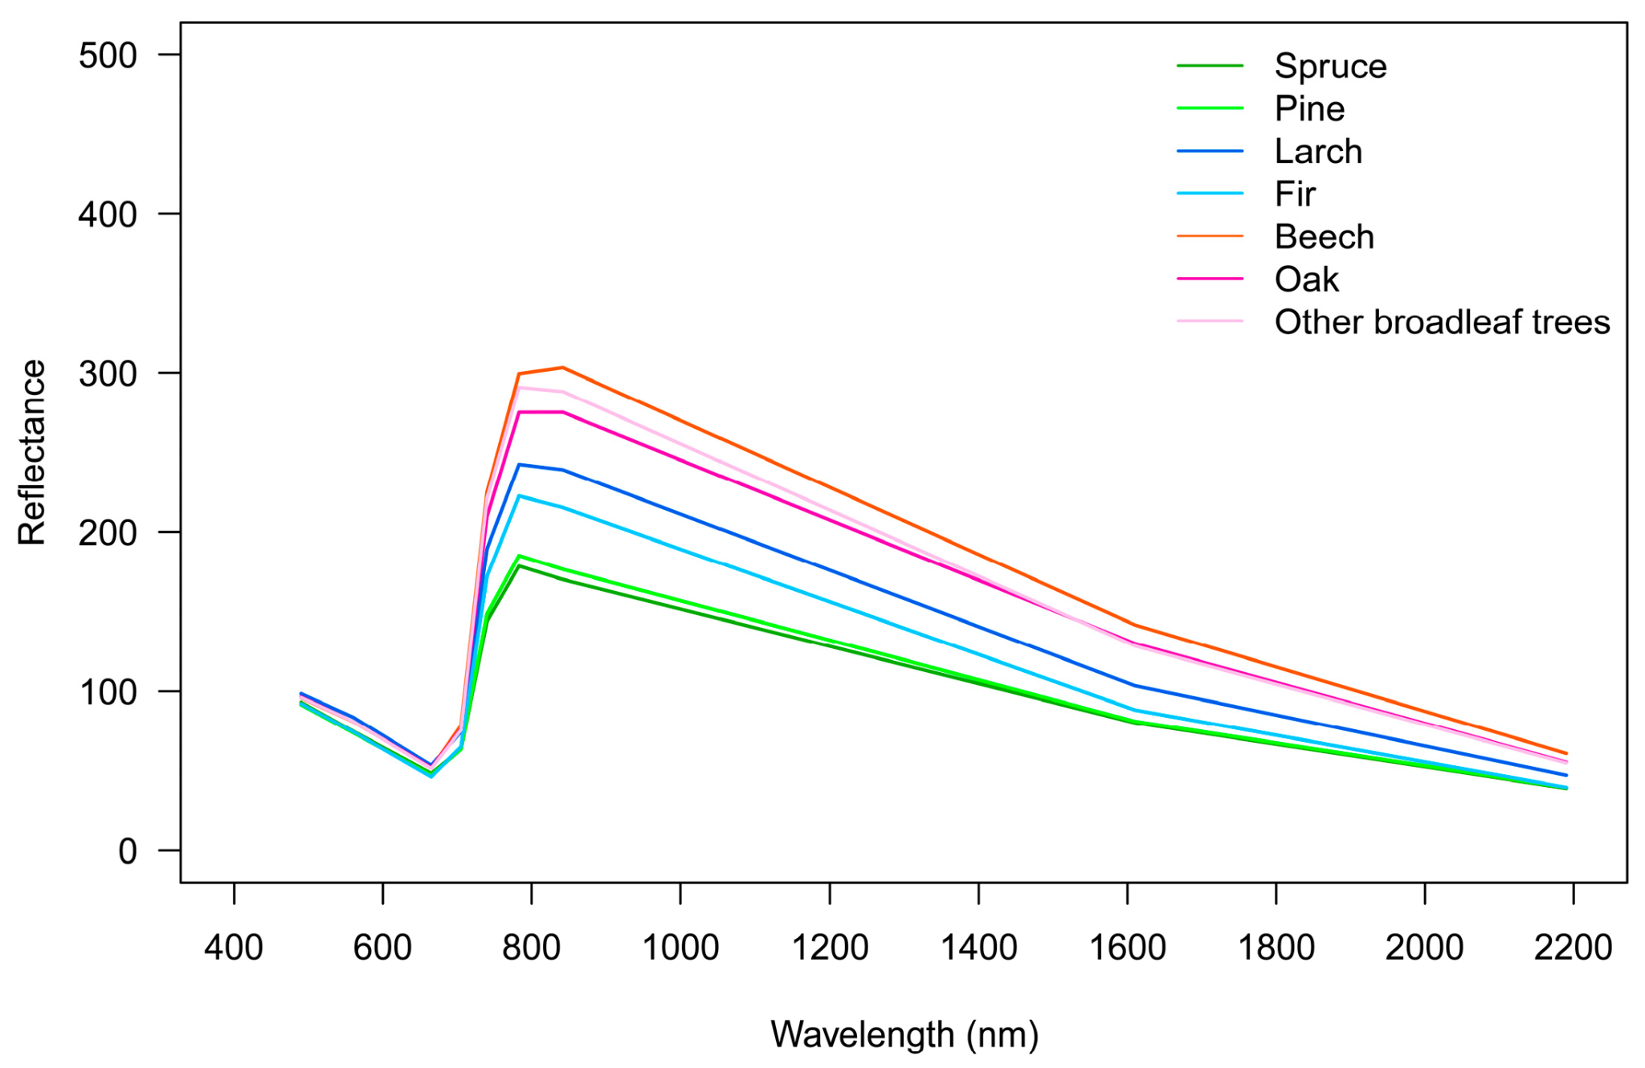
Biodiversity Mapping
(above) Sentinel-2 scene of forest test site and (below) average spectral signatures of tree species (Spruce, Pine, Larch, Fir, Beech, Oak, broadleaf)
Measurable Indicators and Metrics
Immitzer, M., Vuolo, F., & Atzberger, C. (2016). First Experience with Sentinel-2 Data for Crop and Tree Species Classifications in Central Europe. Remote Sensing, 8(3), 166. https://doi.org/10.3390/rs8030166

Slide 15
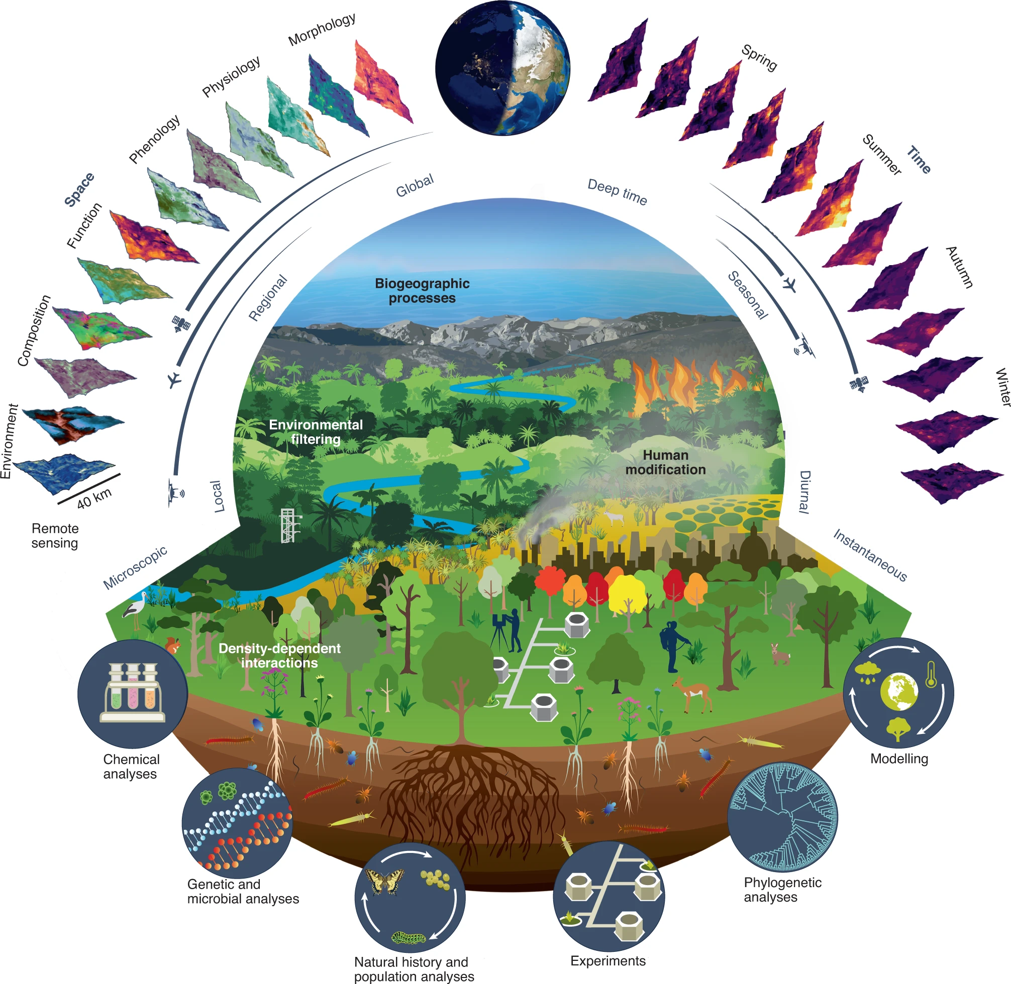
Forestry
Habitat Mapping and Monitoring: Mapping of landcover transformations and identifying critical habitats for protection or restoration. Tracking changes in vegetation cover, deforestation rates, and land use over time.
Wildlife Tracking and Conflict Mitigation: Monitor animal movements and manage human-wildlife conflicts by identifying corridors that minimize habitat disruptions.
Illegal Activity Detection: Detect activities like deforestation in protected areas, enabling timely interventions.
Cavender-Bares, J., Schneider, F.D., Santos, M.J. et al. Integrating remote sensing with ecology and evolution to advance biodiversity conservation. Nat Ecol Evol 6, 506–519 (2022). https://doi.org/10.1038/s41559-022-01702-5

Slide 16

Remote Sensing

Slide 17
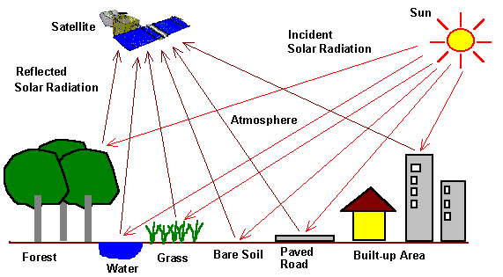
Remote Sensing
“Remote sensing is the process of collecting information about the Earth’s surface without physical contact, typically using satellites, drones, or aircraft.”
Working:
Sensors detect reflected or emitted electromagnetic radiation from objects on Earth
Data is captured as images or spectral measurements
Types
Passive → Uses natural energy (e.g., sunlight reflected from Earth)
Active → Uses emitted energy (e.g., RADAR, LiDAR)
Data
Raster data → Pixel-based imagery (satellite or aerial images)
Spectral bands → Visible, infrared, thermal, microwave

Slide 18
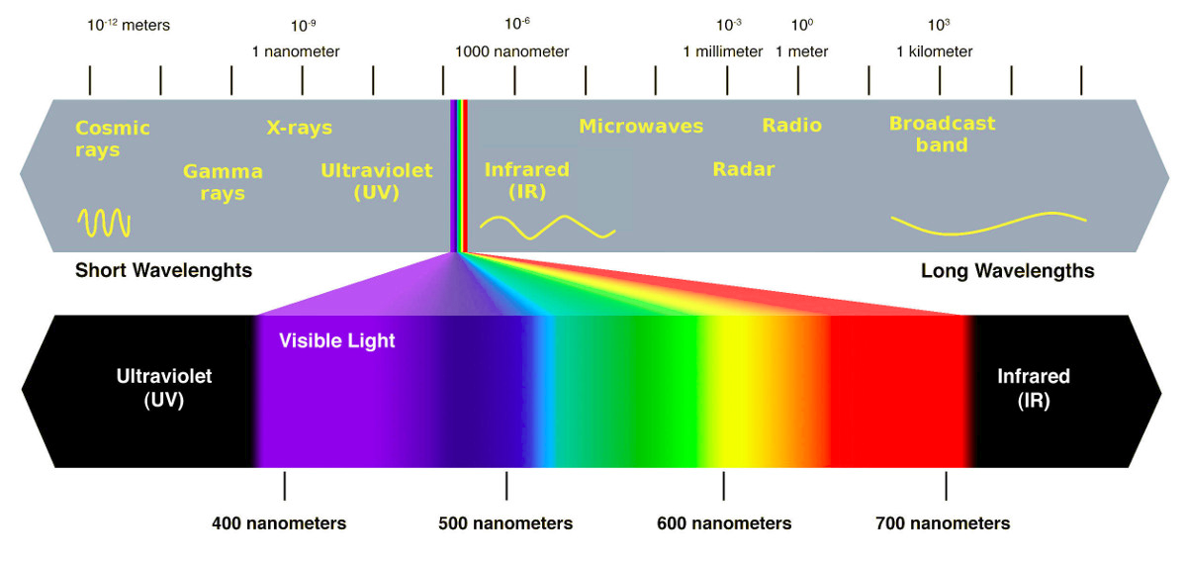
Satellite Imaging and Spectra

Slide 19
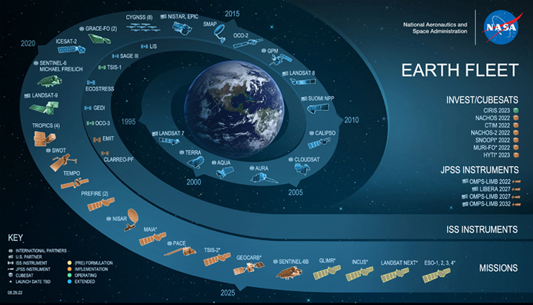

Slide 20
Global Satellite Fleet
Optical Data
1. Sentinel -2
2. Landsat 9, 8,7
3. Planetscope
4. MODIS
5. ASTER
6. WORLDVIEW
7. SPOT
8. JAXA
9. IRS LISS IV
10. Cartosat
11. PROBA-V,
12. AVHRR,
13. GPM/TRMM
Microwave Data
1. Sentinel 1
2. ALOS PALSAR
3. ICEYE
4. RISAT
5. TerraSAR - X
6. RADARSAT
7. KOMPSAT 6
8. TanDEM-x
9. NISAR
10. JERS
Hyperspectral
1. HySIS
2. Hyperion
LiDAR
1. ICESat
2. ICESat-2
Others
1. SRTM DEM
2. ASTER DEM
3. VIIRS
Updated as of Aug 2025

Slide 21
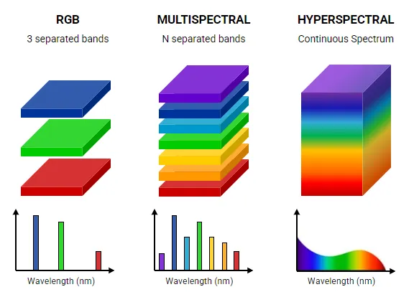
Optical Imagery Types
Source: Nireos

Slide 22
Optical Imagery Types
Feature | RGB | Multispectral | Hyperspectral
Number of Bands | 3 | 4-15 | 100-200 +
Spectral Range | Visible only | Medium | High
Data Volume | Small | Moderate | Very Large
Typical Applications | Photography, basic monitoring | Crop/ vegetation health, LULC | Detailed crop stress, material identification, disease detection & many more
Cost | Low | Moderate | High
Processing Complexity | Low | Moderate | High

Slide 23
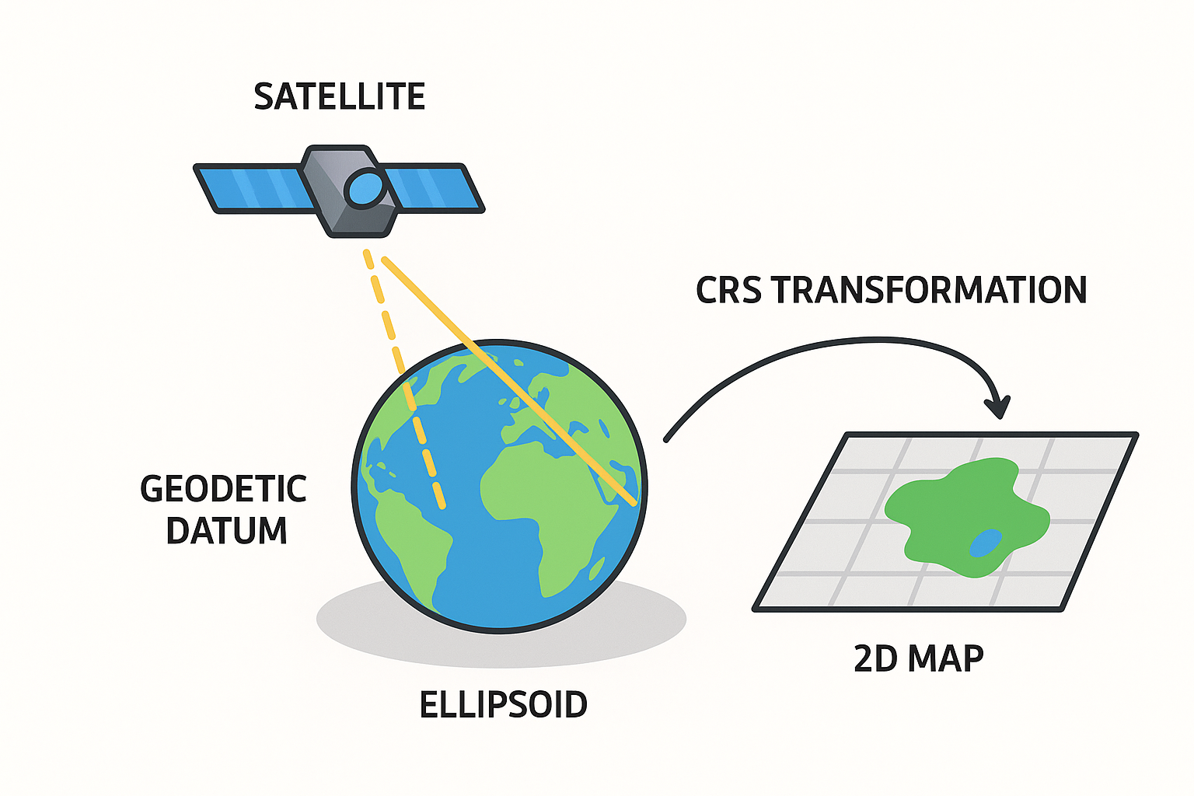
CRS or Coordinate Reference System
1. Coordinate Reference System (CRS)
Defines how geographic locations are represented on a flat map or globe.
It provides a framework to map latitude, longitude, and elevation accurately.
2. Why is it important?
Ensures accuracy in measurements (distance, area, angles)
Allows overlaying multiple datasets correctly
Essential for map projections, spatial analysis, and modeling
3. Types of CRS:
Geographic CRS (GCS):
Based on latitude & longitude
Example: WGS84 (used in GPS and most satellites)
Projected CRS (PCS):
Converts Earth’s curved surface to 2D map
Examples: UTM (Universal Transverse Mercator), State Plane

Slide 24
Data, Compute and Learning!

Slide 25

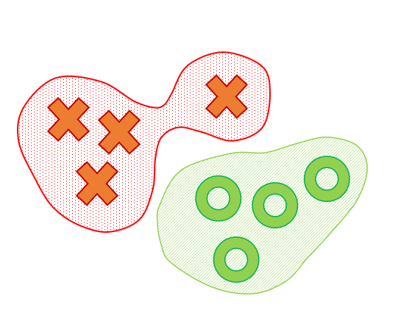
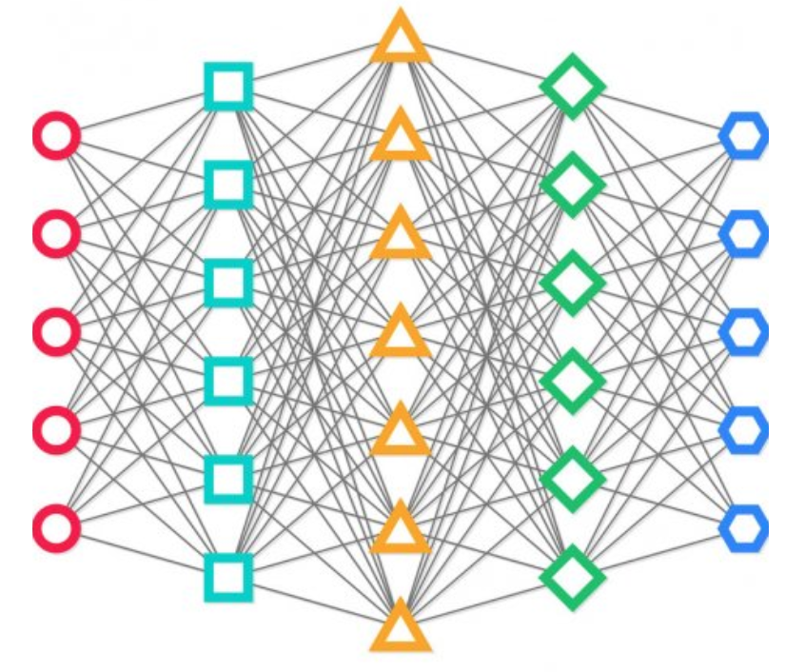



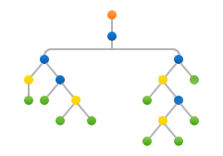












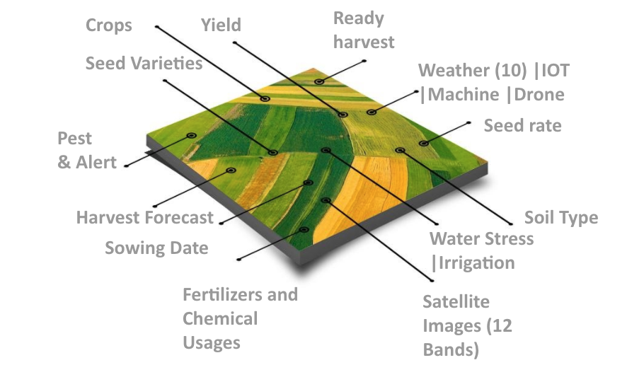





Data
Computing
Learning
Annotations/
Ground Truth/
SME
Cloud
On-premise
Analysis
Ready
Data
(ARD)
Or
Cloud
Optimized
Data
Model
Life Cycle,
Tracking
&
Orchestration
Data Source
&
Ingestion
Workflow
Orchestration

Slide 26





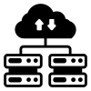










Ecosystem for Agriculture and Food Security
Biological, Knowledge and Field Data (Health, Socio-Economic)
Soil, Weather, Watershed, Irrigation, Land use (SoilGrids, AquaStat, CHIRPS, ECMWF)
Science Models
(DSSAT, DNDC, OpTis, CropSuite) &AI
Geospatial Data (Raster, Vector)

Slide 27



Useful Tools
ArcGIS
Advanced commercial GIS platform for mapping, spatial analysis, and geostatistics
QGIS
Free, open-source GIS tool for editing, analyzing, and visualizing spatial data
Supports a wide range of plugins and data formats, making it flexible for research & teaching
Google Earth Engine (GEE) (focus of today’s workshop)
Cloud-based platform with petabytes of satellite imagery & geospatial datasets
Enables large-scale, real-time analysis of environmental, agricultural, and climate data

Slide 28
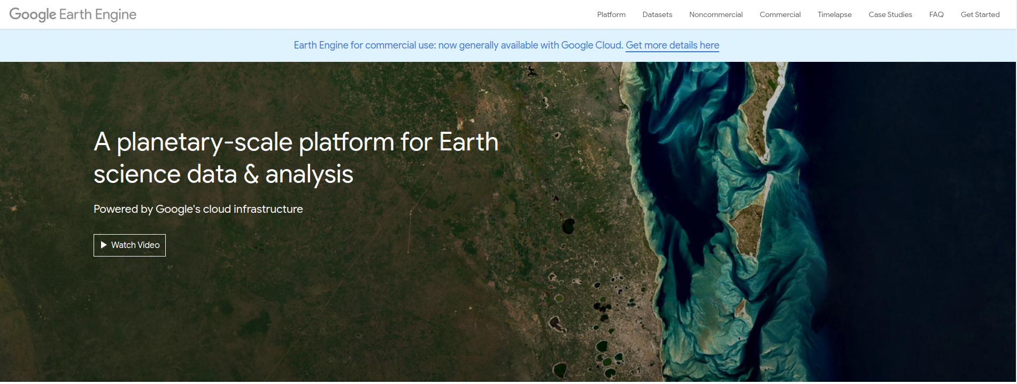
Earth Engine
https://earthengine.google.com/
A planetary-scale platform for Earth science data & analysis

Slide 29
GEE
Definition
Cloud-based platform for planetary-scale geospatial analysis
Enables users to visualize, analyze, and process vast amounts of satellite imagery and geospatial data
Supports remote sensing research, environmental monitoring, and global decision-making
Features
Access to massive geospatial archives → Satellites, precipitation, LULC maps, climate, and weather data
Process large datasets → Perform complex analyses at planetary scale using cloud infrastructure
Visualize results → Interactive maps, charts, and export options
Develop algorithms → Web-based code editor with JavaScript & Python APIs
Applications
Environmental Monitoring: Deforestation, water resources, vegetation health, land cover changes
Disaster Response: Flood mapping, wildfire monitoring, earthquake damage assessment
Resource Management: Agriculture, forestry, climate impact studies
Climate Science: Study temperature/precipitation trends, model climate change effects
Urban Planning: Monitor urban growth and land use changes
Health & Business: Disease outbreak prediction, supply chain risk assessment

Slide 30

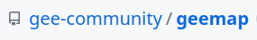
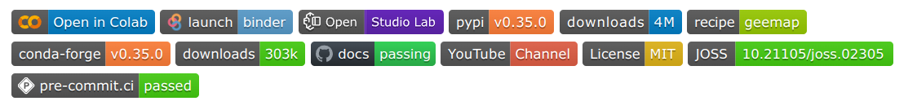
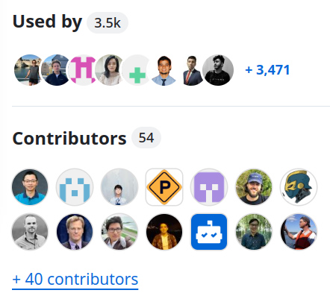
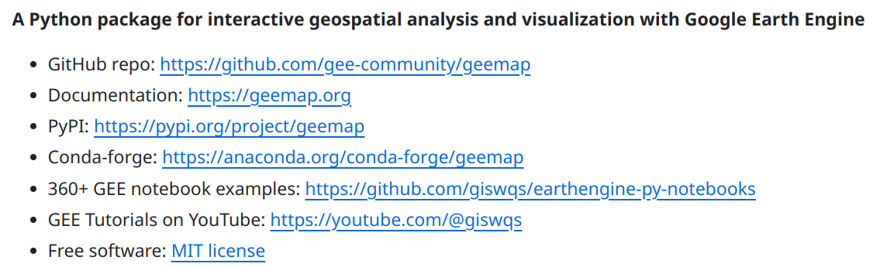
Geemap
GitHub: https://github.com/gee-community/geemap
Website: https://geemap.org
Notes:
Intro to the geemap GitHub repository.

Slide 31
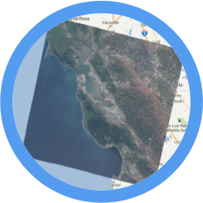
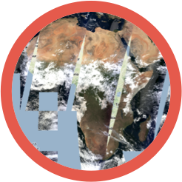
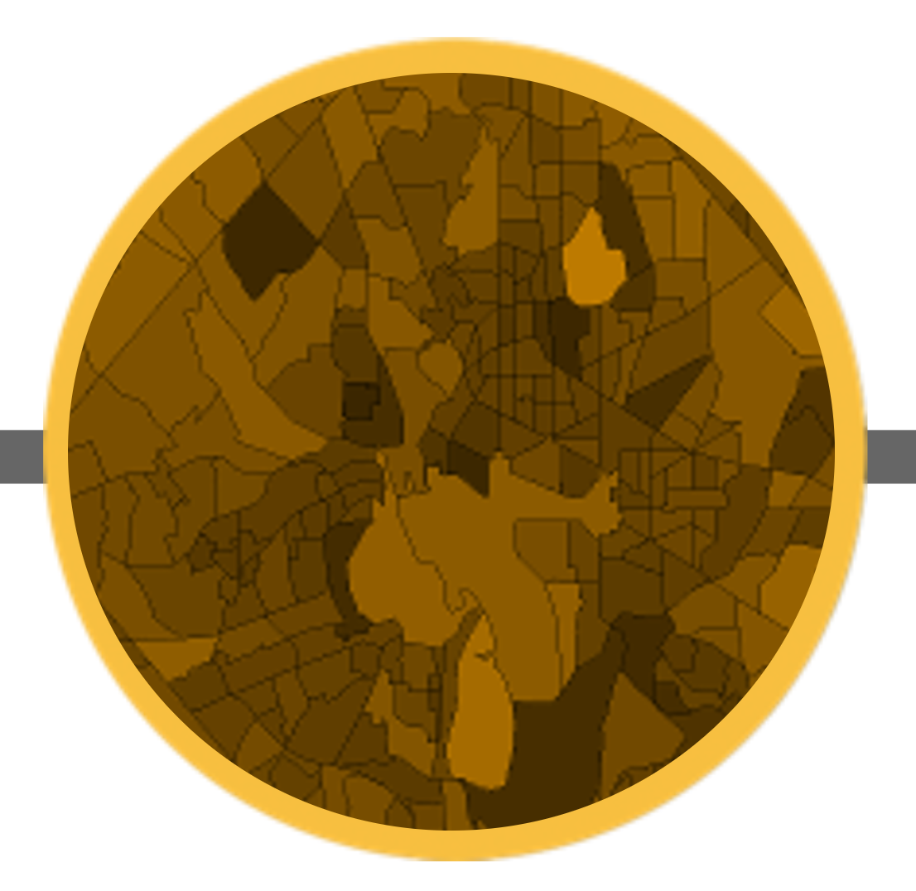
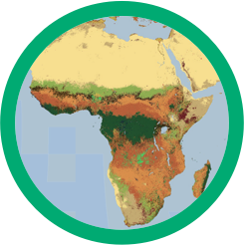
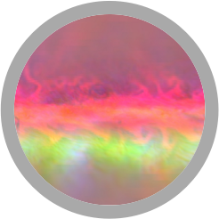
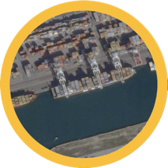
Earth Engine Data Catalog
https://developers.google.com/earth-engine/datasets/
Landsat & Sentinel
10-30m, weekly
MODIS
250m daily
Vector Data
WDPA, TIGER, WHC
Terrain &
Land Cover
Weather & Climate
NOAA NCEP, OMI, ...
... and upload your own vectors and rasters
1000+ public datasets
100+ petabytes (PB) of data = 100K+ TB
100+ datasets added yearly
1+ PB of new data every month
Credits to Earth Engine Team
Notes:
Credits to Michael DeWitt: https://docs.google.com/presentation/d/1BaGOANsu5wxLpbcXpMc5zYcrfP1x8PbxjHXMpG6qYQ4/edit#slide=id.g60040e5540_0_598

Slide 32
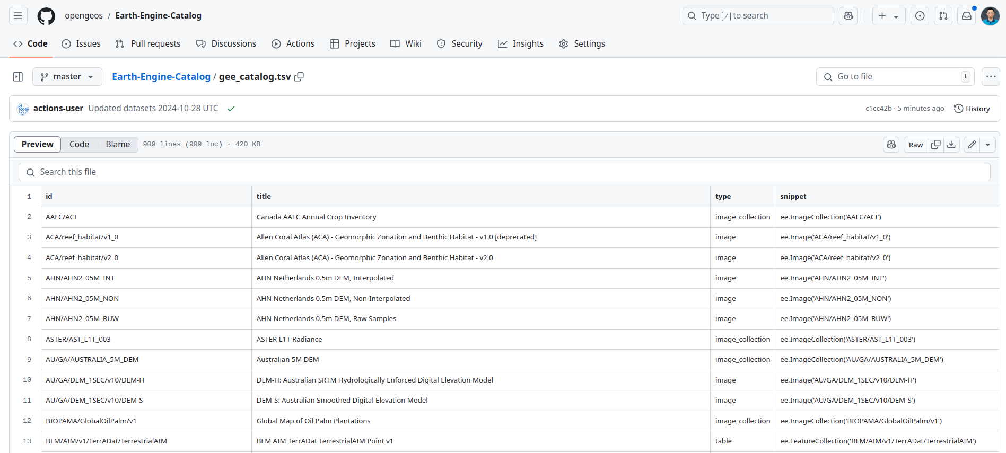
Earth Engine SpatioTemporal Asset Catalog (STAC)
https://earthengine-stac.storage.googleapis.com/catalog/catalog.json
https://github.com/opengeos/Earth-Engine-Catalog/blob/master/gee_catalog.tsv

Slide 33
Catalog of Image Collections
Satellite Imagery - Optical and radar imagery for land, vegetation, water, and urban monitoring. Examples: Landsat, Sentinel
Elevation & Topography - Digital representations of terrain to analyze slope, aspect, and elevation. Examples: SRTM (Shuttle Radar Topography Mission) , ASTER GDEM
Climate & Weather Data - Observed or modeled climate and meteorological variables for environmental studies. Examples: ERA5 Reanalysis, CHIRPS
Land Cover & Land Use - Classification of Earth's surface into forests, croplands, urban areas, Examples: ESA WorldCover, GlobCover
Hydrology & Water Resources - Datasets capturing water bodies, rivers, lakes, wetlands, and water-related indices. Examples: JRC Global Surface Water, GRWL
Socioeconomic & Population Data - Spatial datasets related to humans, settlements, and socioeconomic. Examples: VIIRS Night-Time Lights, WorldPop
Custom & Derived Collections - User-generated or processed datasets for specific analyses. Examples: NDVI / EVI time-series, Cloud-free mosaics

Slide 34
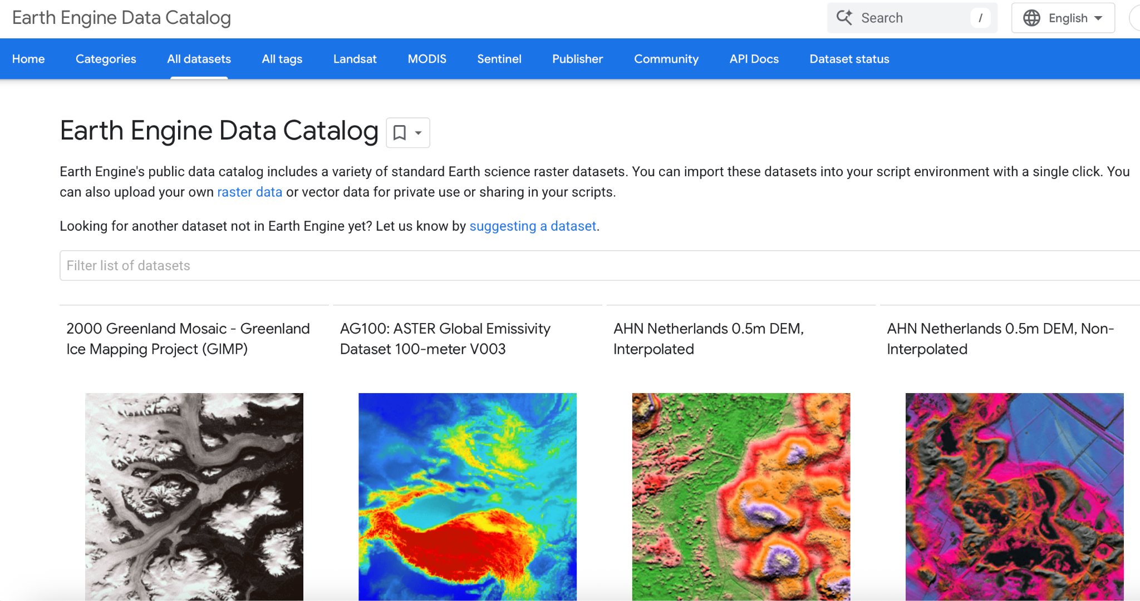
Exploring the available Datasets

Slide 35
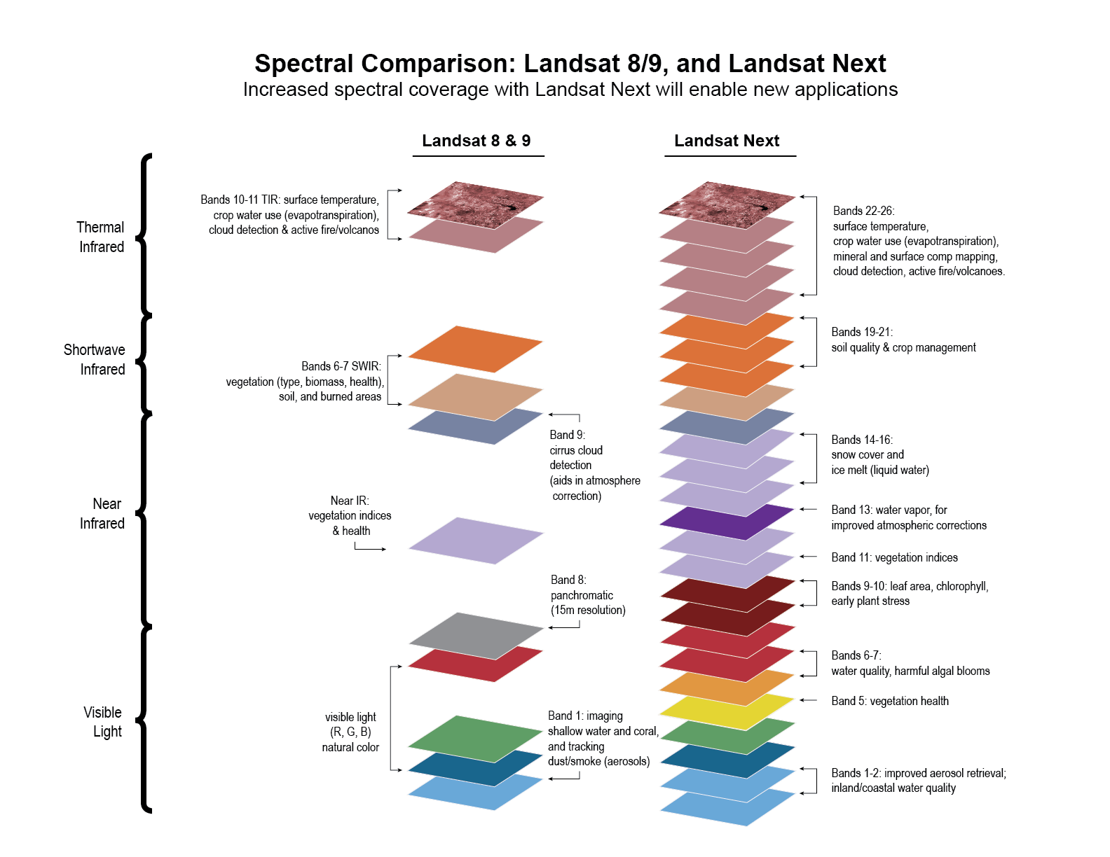
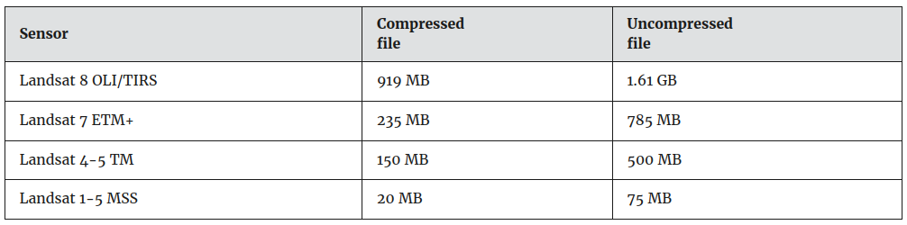
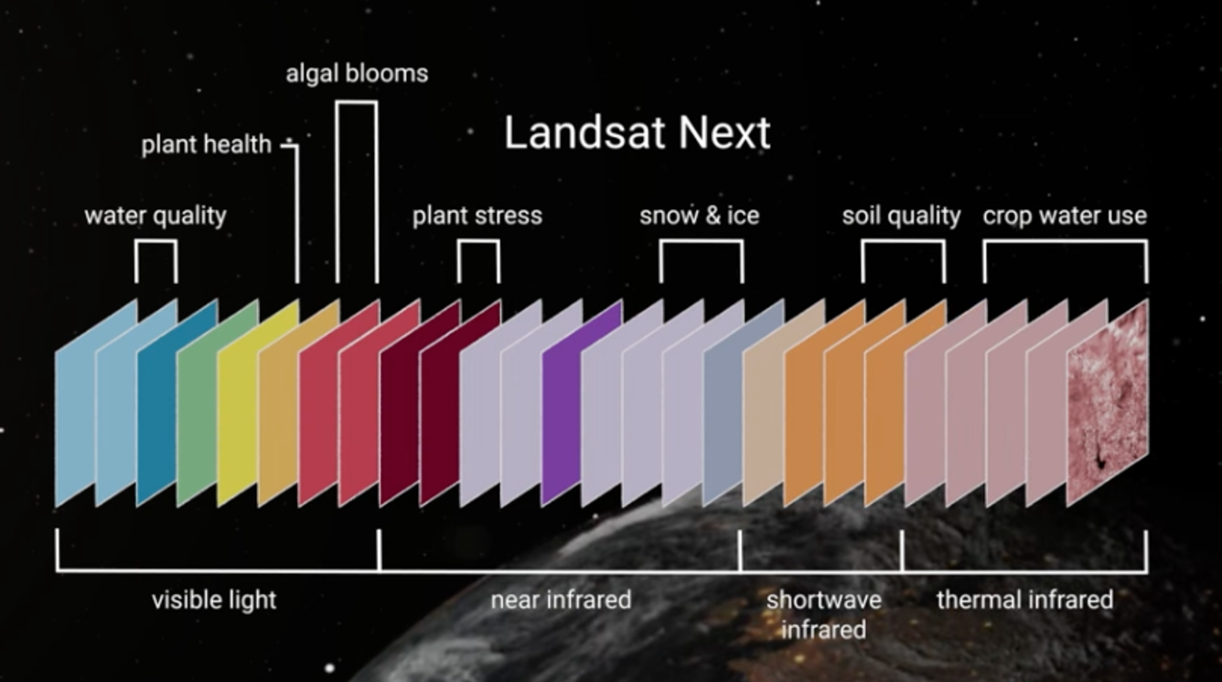
Landsat Next
https://www.usgs.gov/landsat-missions/landsat-next
scheduled to launch in late 2030 or early 2031
30 meters vs. 10 meters
11 bands vs. 26 bands
1 GB vs. 20 GB
Notes:
https://www.usgs.gov/faqs/what-are-landsat-collection-1-level-1-data-product-file-sizes

Slide 36




Compute-GEE and Google Cloud
Recently integrated
GEE
Google Cloud Bucket

Slide 37


Demo and Check-in
Google Earth Engine Account Set up
Project Initialization
Go to https://code.earthengine.google.com/
Create and choose appropriate plan
Open Colab: http://colab.research.google.com/

Slide 38
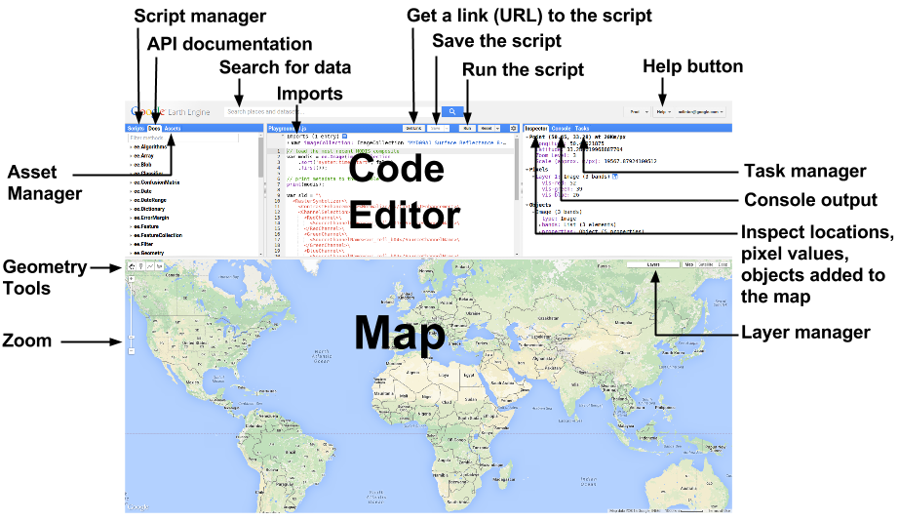

Slide 39
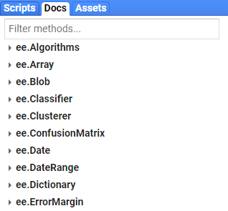
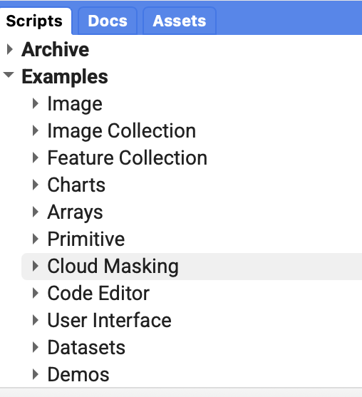
Resources For Help
Docs Tab
Example Scripts
Developer’s Guide
Google Earth Engine Developers Group

Slide 40
Vector Data
Collection of geographic features represented as points, lines, or polygons, each with associated attributes is known as vector data.
Describes discrete data such as countries, rivers or provinces.
Accessible as Feature Collections in GEE
Important Vector Data in GEE
GAUL (FAO Global Administrative Unit Layers) - Geographic boundaries
HydroSHEDS (Hydrological Data and Maps) - rivers
GHSL (Global Human Settlement Layer) - built-up/urban polygons and many more.

Slide 41


Vector data in GEE
var dataset = ee.FeatureCollection("DATASET_ID");
var filtered = dataset.filter(ee.Filter.eq('PROPERTY_NAME', 'VALUE'));
Map.addLayer(filtered, {color:'COLOR'}, 'Layer Name');
Sample:
var dataset = ee.FeatureCollection("FAO/GAUL/2015/level1");
var filtered = dataset.filter(ee.Filter.eq('ADM0_NAME', 'India'));
Map.setCenter(79.68, 22.88, 6)
Map.addLayer(filtered, {color:'red'}, 'India States');

Slide 42
Simple Example

Slide 43

Importing GEE Datasets
Search Data

Slide 44

Importing GEE Datasets
Go to https://code.earthengine.google.com/
At the top of the page, use the search bar to search for datasets of interest (eg. “ESA WorldCover 10m v100”)
Select the appropriate dataset and click “Import”
The asset will appear as a new table under “Imports” in the central panel. Rename the dataset.
var visualization = {
bands: ['Map'],
};
Map.addLayer(imageCollection, visualization, 'ESA WorldCover 10m v100')

Slide 45
Image Collection in GEE
A sample template for loading the collection:
var collection = ee.ImageCollection("DATASET_NAME")
.filterDate(START_DATE, END_DATE) // filter by date
.filterBounds(ROI) // filter by ROI
.filter(ee.Filter.lt(METADATA_FIELD, THRESHOLD_VALUE));
Example:
var roi = ee.Geometry.Point([76.4910, 9.0886]) // Example: Amritapuri
.buffer(5000); // 5 KM buffer
var collection = ee.ImageCollection("COPERNICUS/S2_SR")
.filterDate(startDate, endDate)
.filterBounds(roi)
.filter(ee.Filter.lt('CLOUDY_PIXEL_PERCENTAGE', 20));

Slide 46
Exporting Options
Template to export an image to google drive
Export.image.toDrive({
image: IMAGE_OBJECT, // The ee.Image you want to export
description: "EXPORT_NAME", // Task name shown in Tasks tab
folder: "FOLDER_NAME", // (Optional) Google Drive folder
fileNamePrefix: "FILE_NAME", // (Optional) file name prefix
region: ROI, // ee.Geometry (area to export)
scale: SCALE_IN_METERS, // e.g., 10 for Sentinel-2, 30 for Landsat
crs: "PROJECTION", // (Optional) coordinate system, e.g. "EPSG:4326"
fileFormat: "FORMAT", // Output format
maxPixels: 1e13 // Increase if large export
});

Slide 47

Example:
Export.image.toDrive({
image: composite,
description: "Sentinel2_Export",
folder: "GEE_Exports",
fileNamePrefix: "Amritapuri_S2",
region: roi,
scale: 10,
fileFormat: "GeoTIFF"
});
Supported fileFormat options for export to drive: GeoTIFF, TFRecord.
If you’re exporting tables (Export.table.toDrive()), then you can also use "CSV", "SHP", "GeoJSON", "KML".

Slide 48
Google Cloud Storage
Export to Google Cloud Storage
Export.image.toCloudStorage({
image: composite,
description: 'Sentinel2_CloudExport',
bucket: 'your-bucket-name',
scale: 10,
region: roi
});

Slide 49
Export to Earth Engine Asset
Export.image.toAsset({
image: composite,
description: 'Sentinel2_Asset',
assetId: 'users/your_username/sentinel2_amritapuri',
scale: 10,
region: roi
});

Slide 50
Reduction on Data
Reduction in GEE means summarizing many values into fewer values using a statistical function (like mean, max, sum, etc.).
Various ways of reducing in GEE
ImageCollection reduction → Combine multiple images over time into one
Image reduction → Summarize pixel values in a region
FeatureCollection reduction → Summarize attributes across features
var reducedImage = image.reduceRegion({
reducer: ee.Reducer.mean(), // can be mean, max, min, median etc.
geometry: roi,
scale: 30
});
var reducedCollection = collection.reduce(ee.Reducer.mean());

Slide 51


Image reduction to scalar
Image Collection reduction to composite

Slide 52

Case Studies
https://github.com/praveenpankaj/icsrf-geoai-tutorial/

Slide 53
NDVI Estimation

Slide 54

Normalized Difference Vegetation Index

Slide 55



NDVI Estimation

Slide 56
Github Repo Code

Slide 57
Thanks
praveenpankaj@ieee.org

